Slide 1
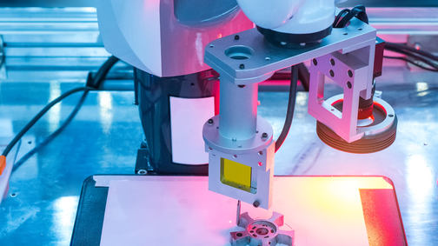



Vision Guided Robotic Arm
GROUP 6
Guided By : Dr. Redouane Khemmar
Team Members:
Aravind Charuvil Kumaran
Abhiram Allipra
Loyid Andrews
Prathamesh Yawalkar

Slide 2

Contents
Context and Objective
Provisional Planning
Problems Faced and Solutions
Algorithms and Results
Modified Architecture
Applications
Lessons Learned
Conclusion

Slide 3

Objective
Upgrading an existing Robotic arm by incorporating computer vision.
01
Using an algorithm to enable the use of image processing required for detection.
02

Slide 4

Provisional Planning
Study of the Environment
Feasibility
Build A Software Model
Hardware Study
Stating Results

Slide 5
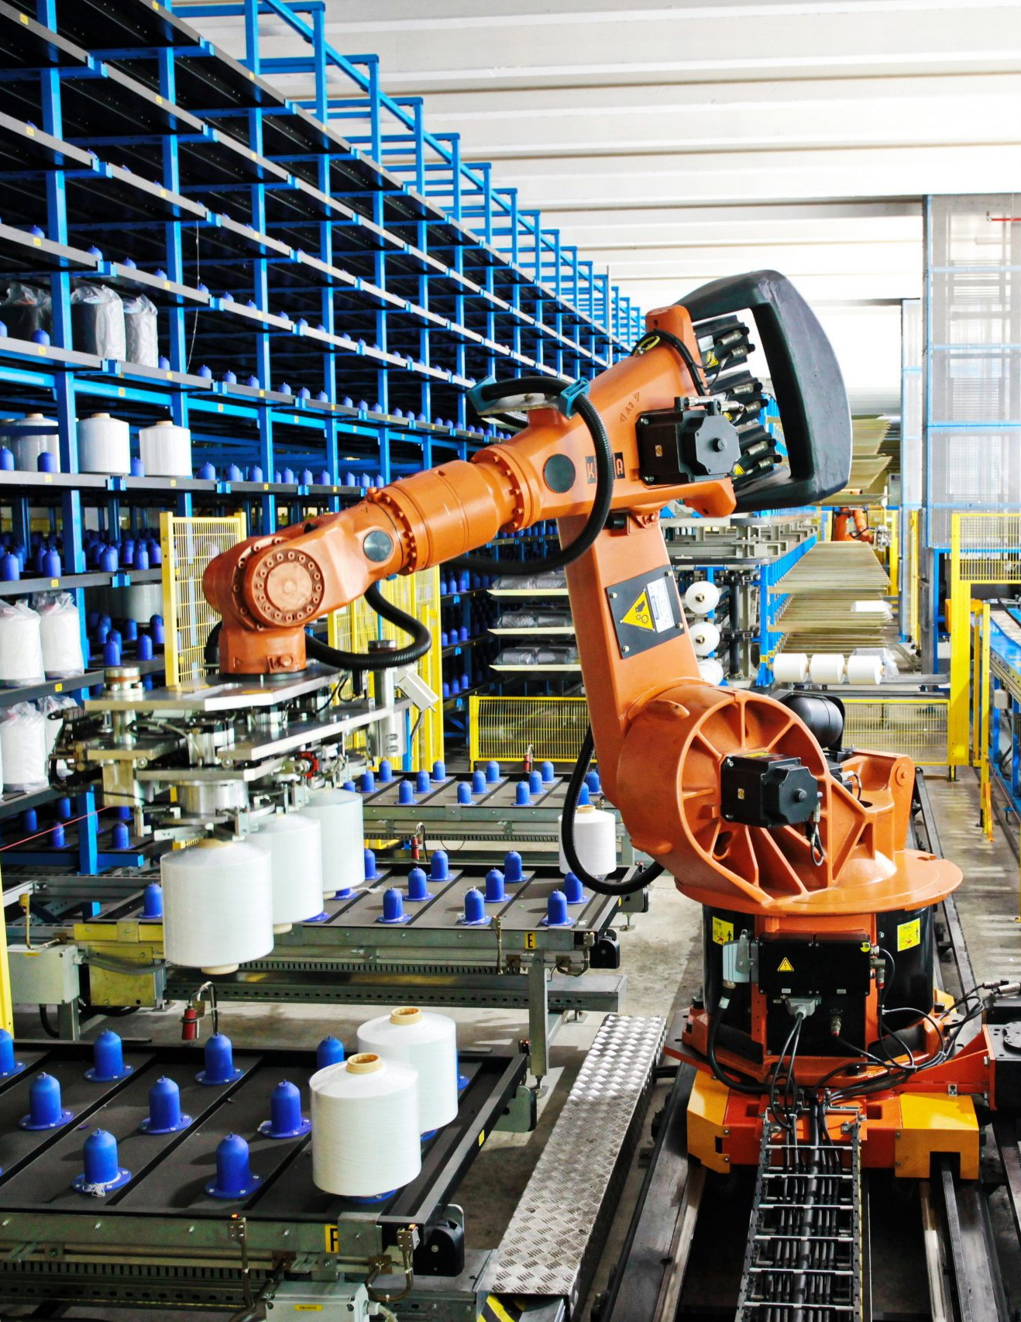
Provisional Planning
Study of the Environment
Operating environment
Application research
Operation defenition

Slide 6
Provisional Planning
Feasibility
Algorithms feasibility
Hardware feasibility

Slide 7
Provisional Planning
Build a Software Model
Dataset creation
Platforms for Execution

Slide 8
Provisional Planning
Hardware Study
Arm physical dimensions
Hardware additional requiremnts

Slide 9
Provisional Planning
Stating Results
Display of the output
Arm movement

Slide 10
Problems Faced
Training of a custom dataset in a local machine
Shortage of a good GPU
Absence of a labelled dataset
Recent Health Crisis and lockdown

Slide 11
Solutions
Training of the dataset under Google Colab platform
Manual labelling of Images
Co-ordinating the project works on Online platforms

Slide 12

Algorithm & Results
YOLO V3
State-of-the-art, real-time object detection system
Fastest and accurate in object detection
Commonly used in speed constrained applications

Slide 13

Algorithm & Results
Working
It uses a totally different approach.
Application of single neural network to the full image.
Division of the images into regions and predicts bounding boxes and probabilities for each region.
These bounding boxes are weighted by the predicted probabilities.

Slide 14
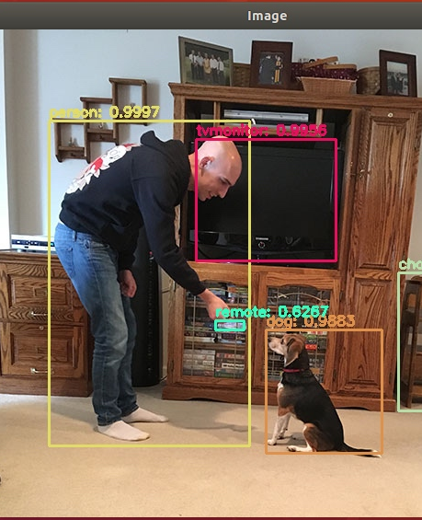
Algorithm & Results
Working
Makes predictions with a single network evaluation.
Systems like RCNN which require thousands for a single image.
This makes it extremely fast.
Reference: Google images

Slide 15
Algorithm & Results
Implementation: Building Darknet
Darknet is a framework to train neural networks.
It sets the architecture of the network.
It is open source and written in C/CUDA and serves as the basis for YOLO.
Downloading of weights and cloning of Darknet to the executing platform

Slide 16
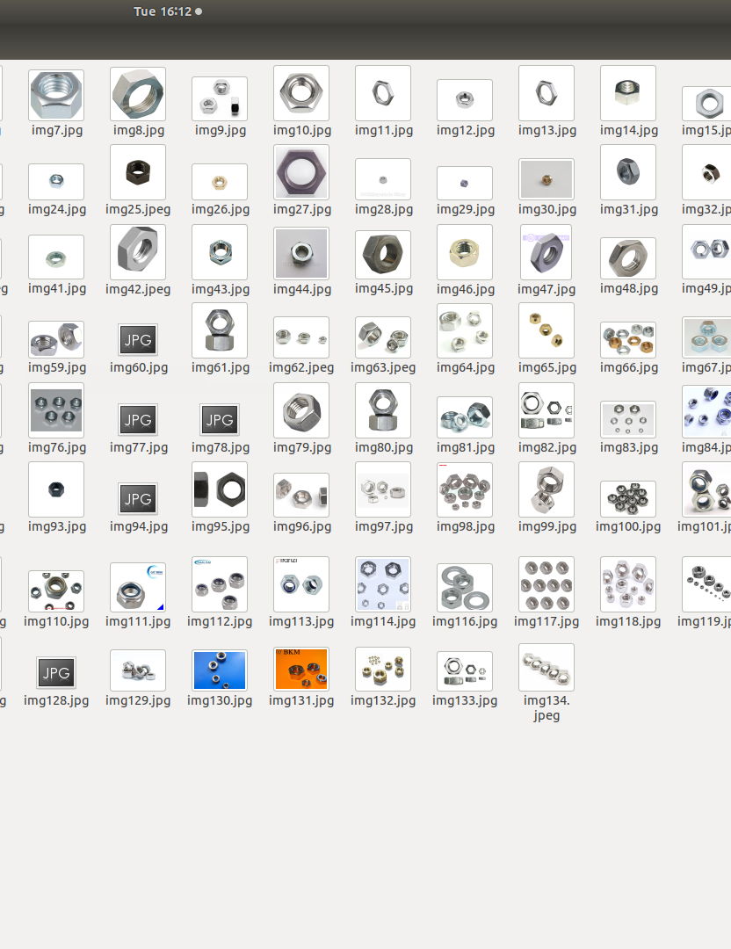
Algorithm & Results
Implementation: Gathering & Labelling
In order to build a custom object detection model, we had to create a custom dataset with the images of the nut.
For feeding the custom made datset into the algorithm it have to be labelled first.

Slide 17
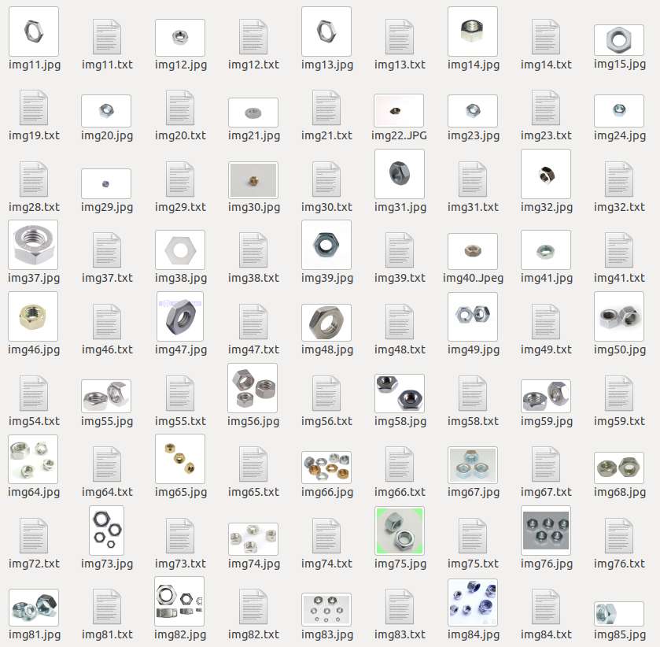
Algorithm & Results
Implementation: Gathering & Labelling
We used a custom labelling method using Labelimg
After the dataset being properly formatted for training, it has to be moved to the training platform.

Slide 18
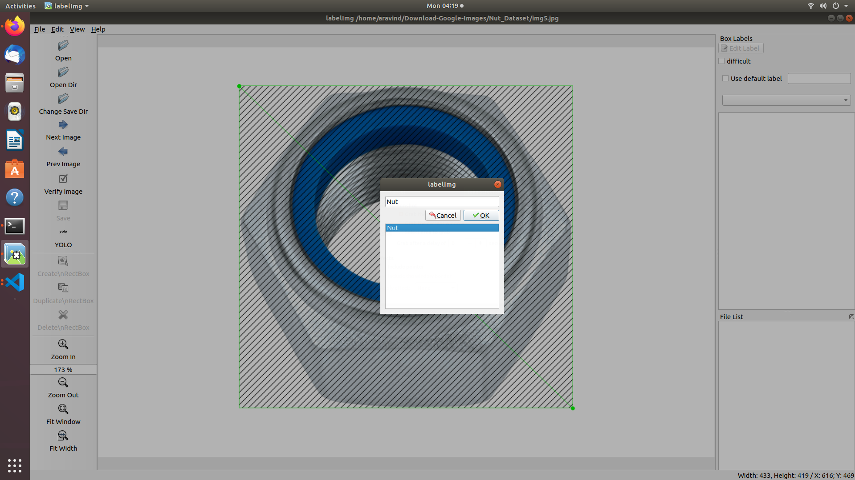
Fig: Manual Labelling of image dataset using the annotation tool “labelimg”

Slide 19
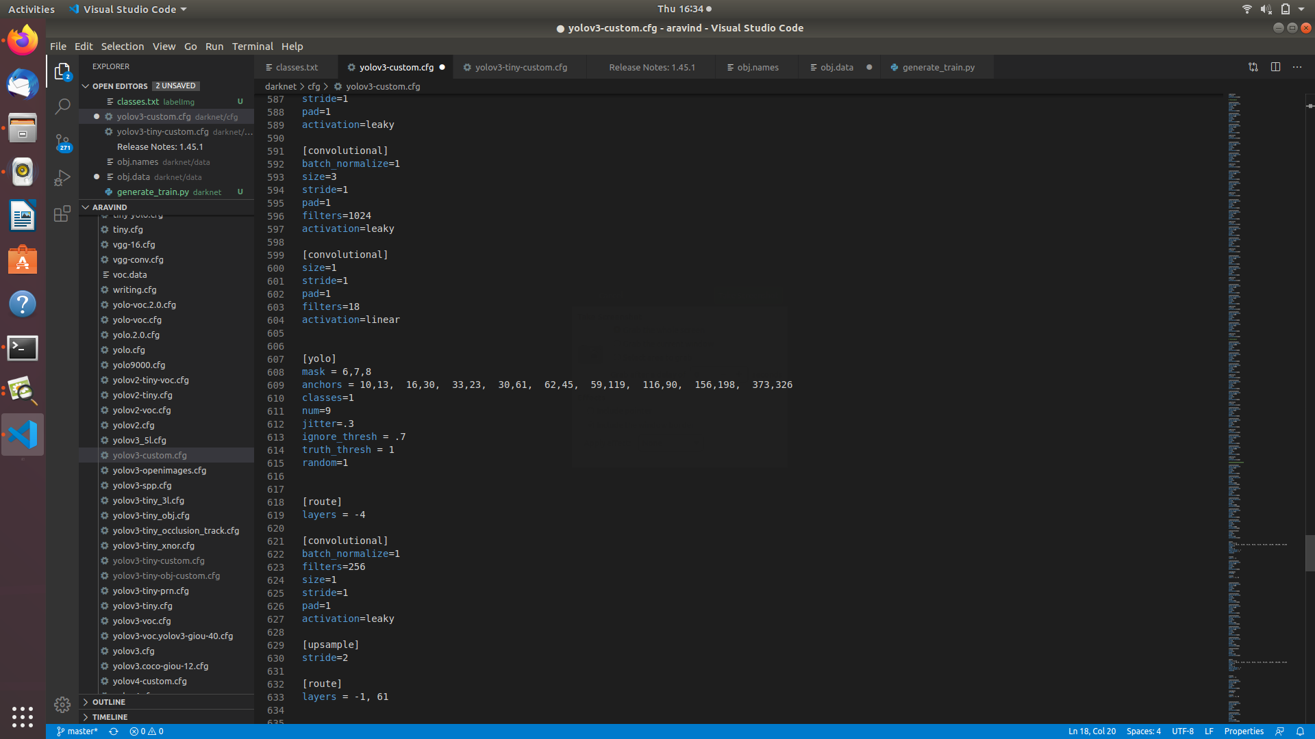
Algorithm & Results
Configuring Files

Slide 20

Algorithm & Results
Training
The trainning of the dataset is the tideous process.
The training undertakes with respect to the details and values provided in the configuration files.
Here 4000 iterations had to be done and it took almost 7 hours to complete.
After the training is finished the model is ready to be fed by an input for detection.

Slide 21
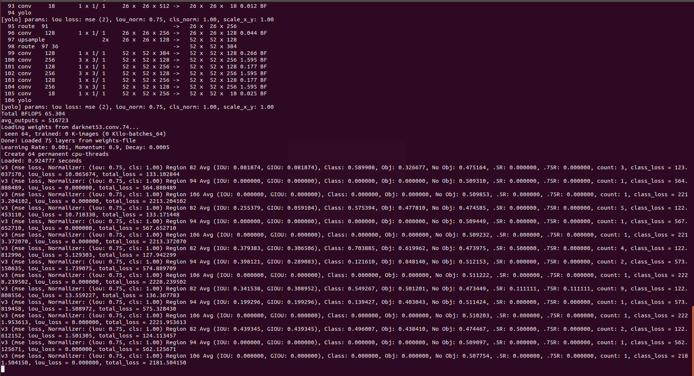
Algorithm & Results
Fig: Screenshot of undergone training

Slide 22
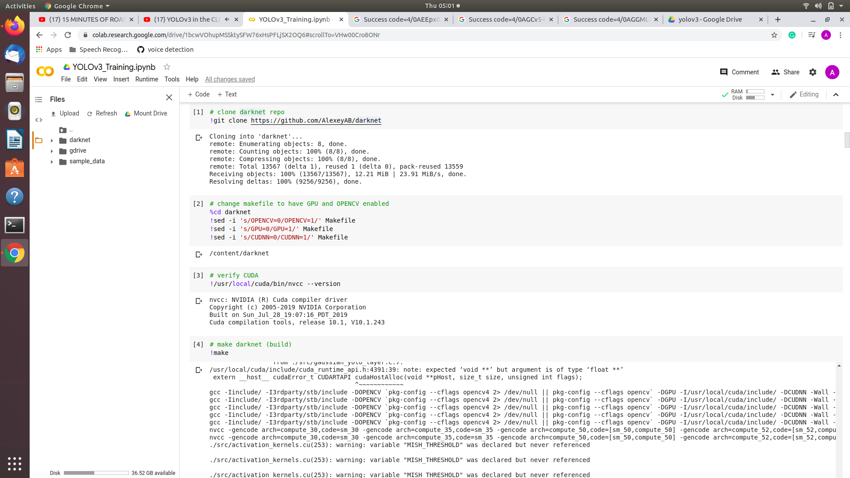
Training Using Google Colab
z
Fig: Screenshot of Google Colab Platform

Slide 23
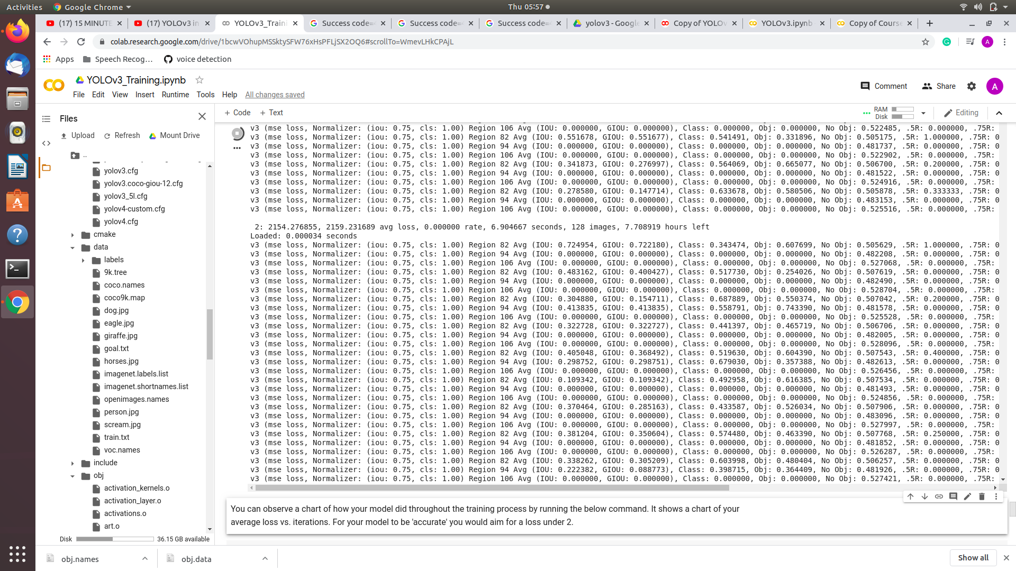
Fig: Screenshot of undergone training

Slide 24
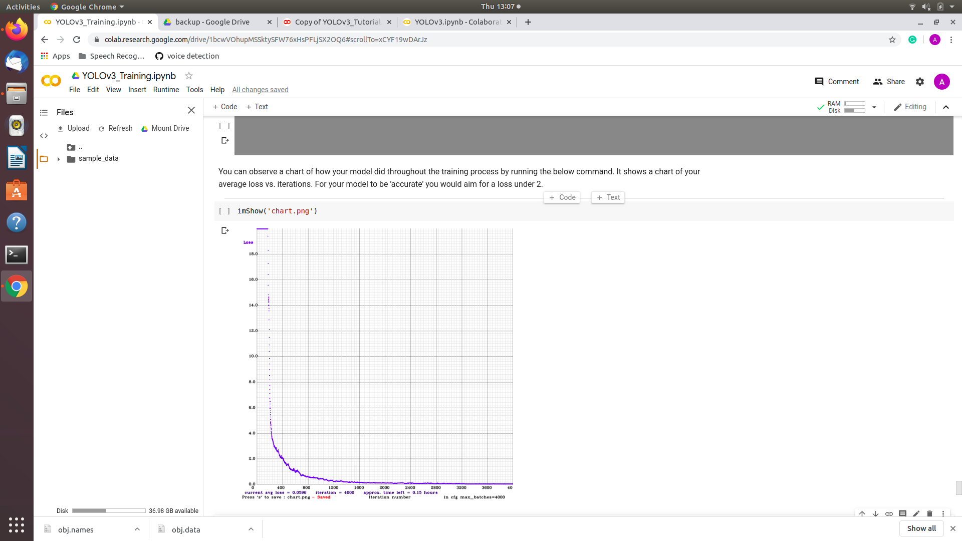
Fig: Screenshot of undergone training

Slide 25
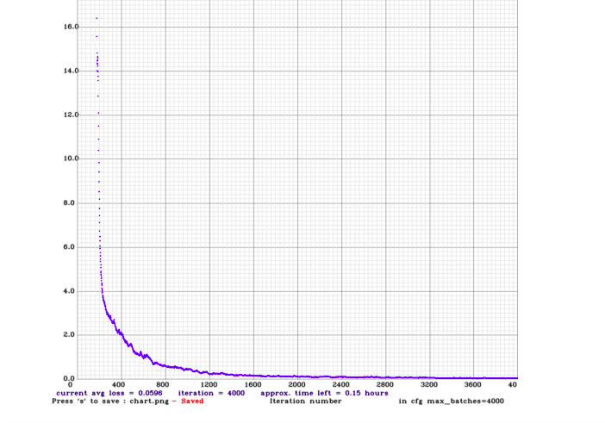
Algorithm & Results
This image represents the output of the training undergone.
The graph is a representation of the loss vs iterations.

Slide 26
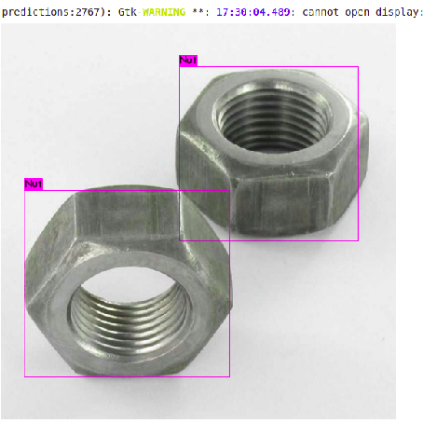
Algorithm & Results
Detection
This is the final stage in the software modelling part.
In this stage an image is fed in to the model for detection.
The output of the model will be the image with the object being detected.
Here we had the nut detected successfully.

Slide 27
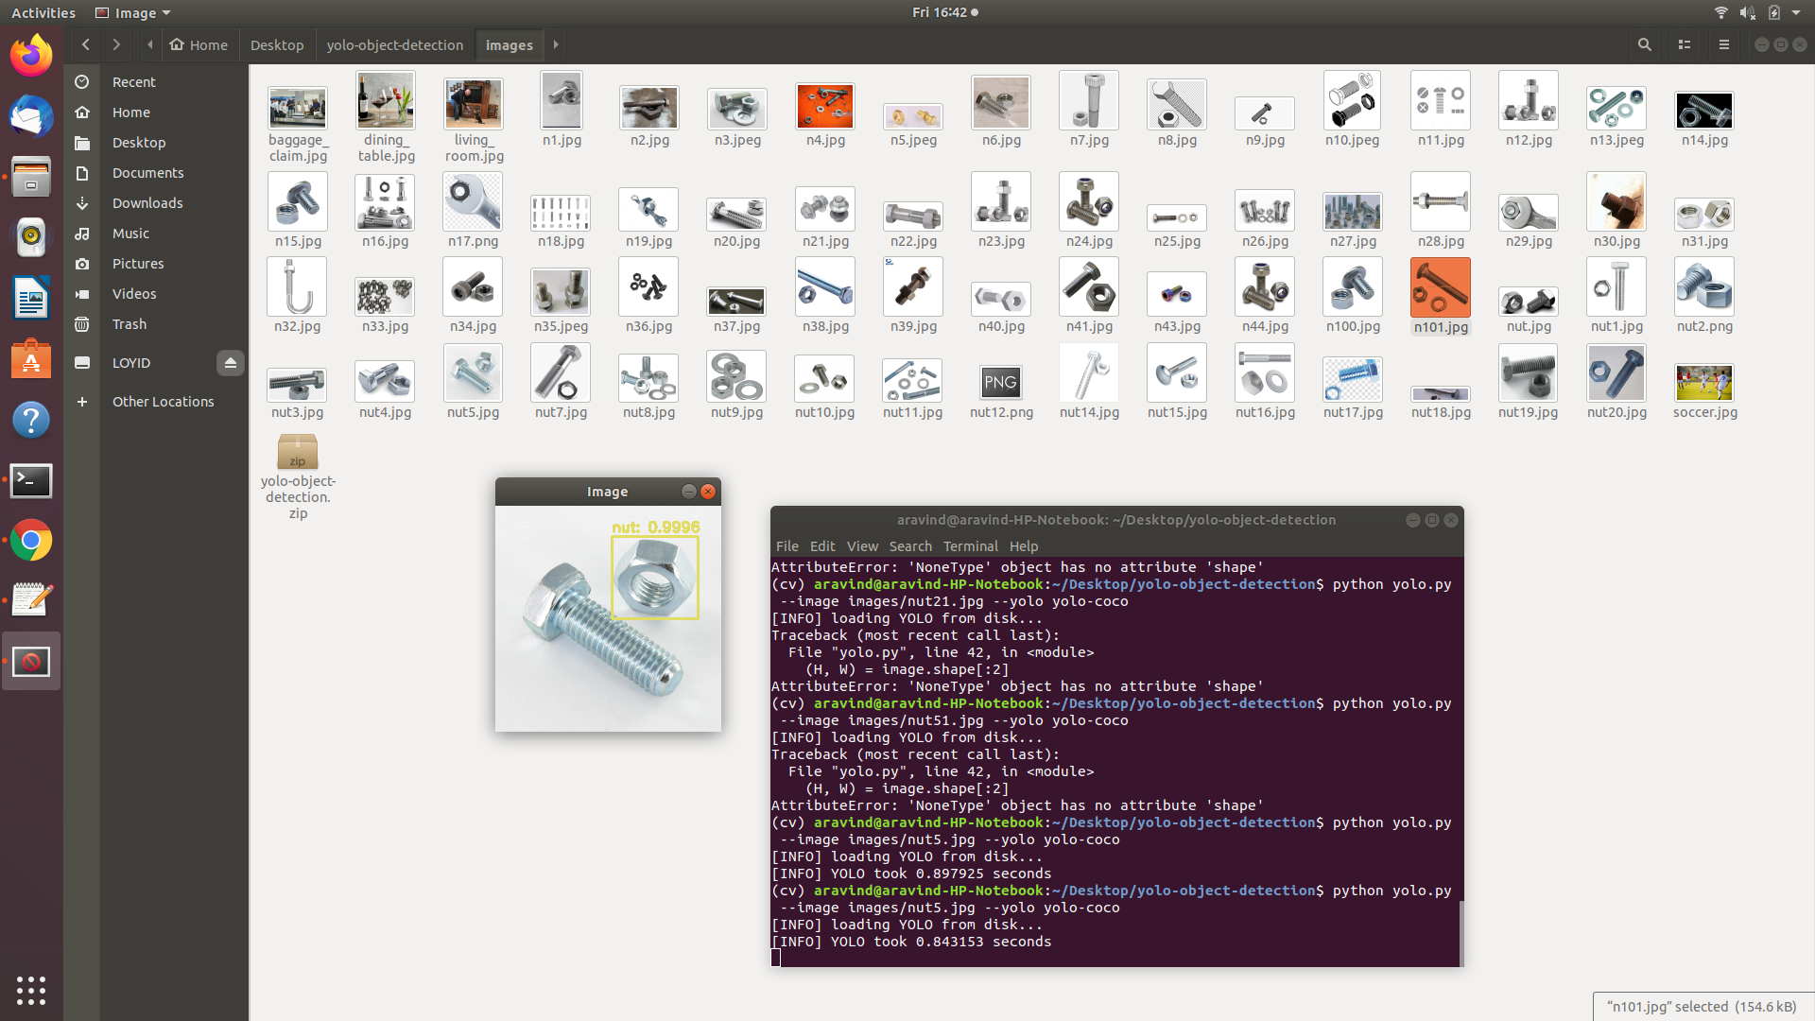
Detection Result

Slide 28
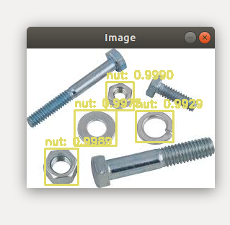
Detection Result

Slide 29

Detection Result

Slide 30
Proposed Modified Architecture
Robot Operating System
A Stereo Vision camera for image capturing and detection
Processing
of data
Semantic mapping and localization
Trajectory planning, tracking and control
Distance Estimation using a disparity Map
Visual Feedback
Odometry

Slide 31
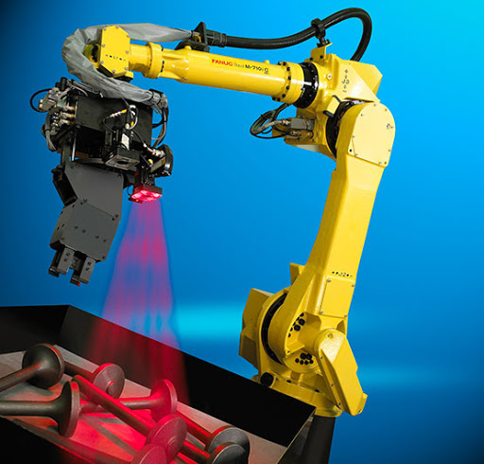
Applications
Picking
Sorting
Quality Checking
Packaging

Slide 32
Lessons learned
Application of YOLO v3
Google Colab Platform
Annotation and labelling of images
Training of a custom Object
Detection of a custom object using OpenCV
Unix shell Programming

Slide 33
Conclusion
The boom of the computational capabilities have served a lot to the applications of deep neural networks in real life
Many industries are seeing high demand for cutting-edge applications in robotic guidance to advance flexible and smart automation.
Improve production efficiency and reduce costs
There is severe shortages in labour resources and that leads to need of automate tasks that are dangerous.

Slide 34
References
https://www.pyimagesearch.com/
https://pjreddie.com/darknet/yolo/
https://deepomatic.com/en/computer-vision/
https://github.com/pjreddie/darknet
https://www.pyimagesearch.com/2018/05/28/ubuntu-18-04-how-to-install-opencv/
https://github.com/theAIGuysCode?tab=repositories

Slide 35
THANK YOU!
z

